Slide 1
KTP Coding
Workshop
Coding in C++: Basics

Slide 2
Chapters
01
02
03
04
05
06
Introduction to C++
Basic Syntax & Structure
Data Types & Variables
Operators
Control Structures
Functions

Slide 3
Chapters (continued)
07
08
09
10
Arrays
Pointers & References
Introduction to Object-Oriented Programing
Conclusion & Q&A

Slide 4

01
Introduction to C++

Slide 5
Importance of C++

Slide 6
C++ Environment Options
Options for C++ Environments:
Visual Studio Code (recommended)
Jupyter Notebooks
Many many more

Slide 7
Visual Studio Code Setup
Download Visual Studio Code
Install both C/C++ and C/C++ Extention Pack from the Extension Menu (C/C++ Themes is also heavily recommended)

Slide 8
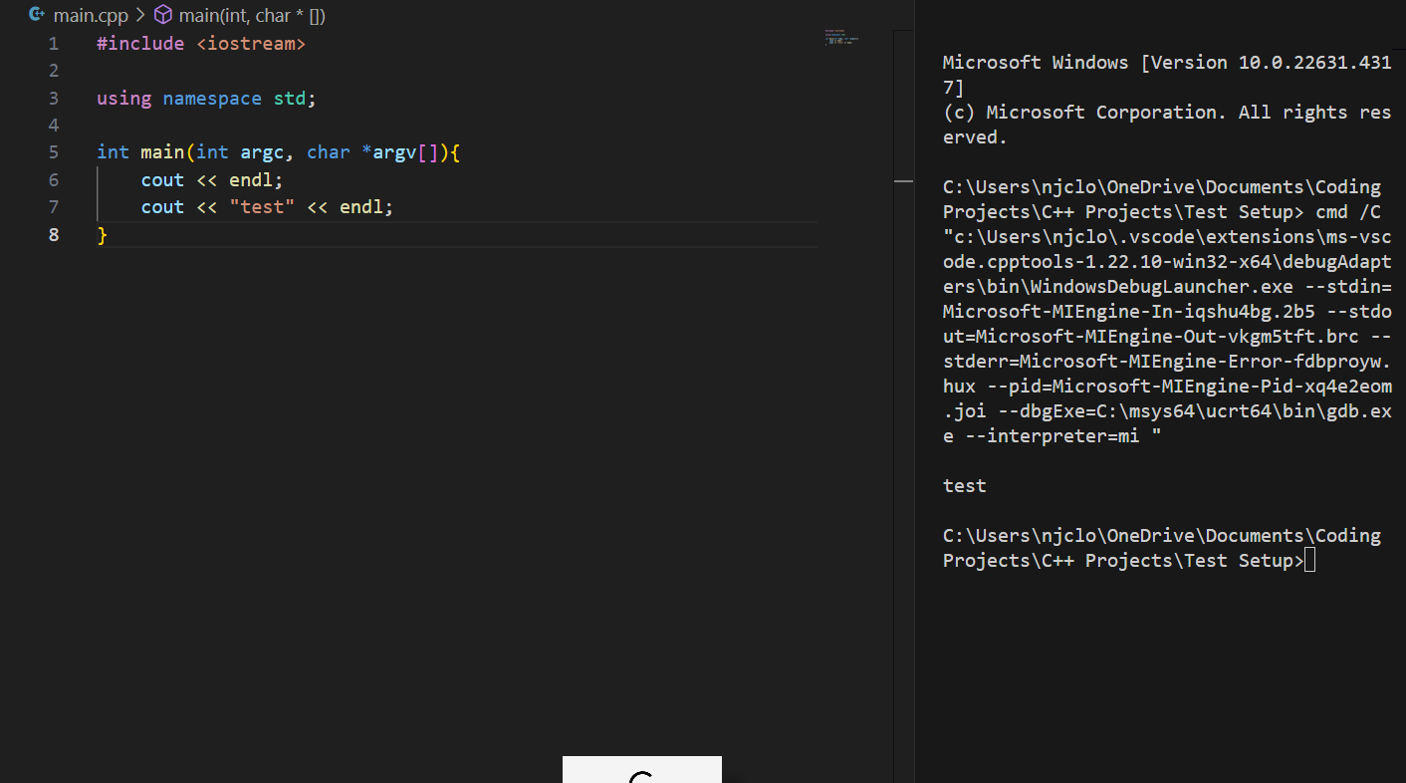
Setup First Project
Create a new project
Within the project file create a file named main.cpp
From here type in the following function:
int main(int argc, char* argv[]){
}
Press the run button and select g++ as the debugger

Slide 9
02
Basic Syntax & Structure

Slide 10
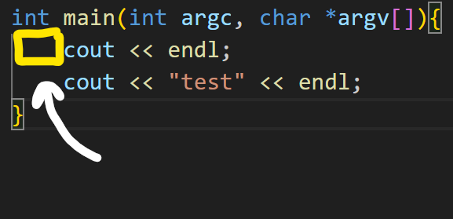
Whitespace
What is whitespace?:
An empty space between or around objects
Examples:
Space
Tab
Why is it important?:
Very important for organization
Some languages use whitespace as a part of the code itself
Overall, whitespace a great aspect to have in any project whether for organization or syntax purposes
Whitespace

Slide 11

Understanding the MAIN Function
The main function is where the program will begin executing it’s code
Segments:
int main - refers to how the main function must return an integer (explained further in chapter 5), this integer refers to the error code that will be displayed upon program completion, the integer will be 0 if there is no error
int argc - the argument count, number of command-line arguments in the
char *argv[] - the argument vector, an array of strings representing each argument

Slide 12
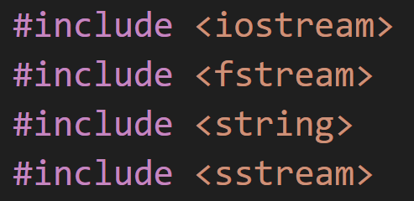
Library Inclusion
Library Inclusion:
Represented by #include (desired file)
Includes the contents of a file into your file before compilation
Allows the programmer to use declarations from other files within the current file
Examples: iostream, fstream, stringstream, string, etc.
iosteam is a library dedicated to handling input and output

Slide 13

Namespaces
Namespaces:
Represented by using namespace (desired namespace)
Used to prevent naming issues between libraries
Makes code more readable
std is the standard namespace of C++ containing standardized names for input and output, strings, data structures, etc.

Slide 14


Basic Output with <iostream>
In order to print information to the terminal the iostream term cout is used followed by << and then what is to be printed
If printing text use quotation marks with your text inside
Ex. cout << “Hello World”;
If printing a variable, type the variables name
Ex. cout << testVar;
To print each line of text on a new line use endl at the end of cout
Ex. cout << “Hello World” << endl;
cout can print multiple things at once, just use << between each (<< does not add a space between objects)
Ex. cout << “Hello World ” << testvar << endl;

Slide 15
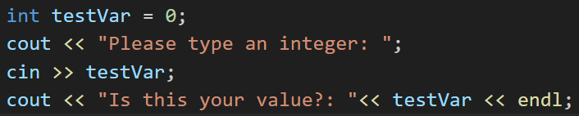


Basic Input with <iostream>
iostream can also be used to gain input from the user. I ask for input type cin followed by >> and then the variable that the input will go into
Ex. cin >> testVar;

Slide 16
03
Data Types & Variables

Slide 17
Primitive Data Types

Slide 18
Boolean
A boolean is

Slide 19
Int
A

Slide 20
Float

Slide 21
Char

Slide 22
<string>

Slide 23
Constants

Slide 24
04
Operators

Slide 25
05
Control Structures

Slide 26
06
Functions

Slide 27
07
Arrays

Slide 28
08
Pointers & References

Slide 29
09
Introduction to Object-Oriented Programming

Slide 30
10
Conclusion & Q&A

Slide 31
Questions?

Slide 32

Sign-Up for Future Classes and Tutoring on our Website

Slide 33
Structure of a Java Program
Import Statements: Allow the use of classes from other packages
Example: import java.util.Scanner;
Class Declaration: defines a class; every Java program must have at least one
Example: public class MyClass {
Main Method: entry point of any Java application
Syntax: public static void main(String[] args) {

Slide 34
Main Method Breakdown
Components:
- public: Access modifier, allows the method to be called from anywhere.
- static: Indicates that the method can be called without creating an instance of the class.
- void: The return type, meaning the method does not return any value.
- String[] args: Parameter that accepts command-line arguments as an array of Strings
-System.out.println(): Prints out whatever is in parenthesis to the console, printed statement must be in quotations unless it is a variable
public class HelloWorld {
public static void main(String[] args) {
System.out.println("Hello, World!");
}
}

Slide 35
Data Types
int
double
Represents integer values (whole numbers)
Ex: int age = 25
Represents floating point numbers (decimals)
Ex: double price = 20.99
char
boolean
Represents a single 16-bit character
Ex: char initial = ‘A’
Represents a true or false value
Ex: boolean check = true

Slide 36
Declaring and Initializing Variables
Variable Declaration:
Syntax: <data type> <variable name>;
Ex:
int count;
double price;
Variable Initialization:
Assign a value to the variable at the time of declaration or after
Ex:
int count = 10; // Declaration and initialization
double price;
price = 99.99; // Initialization after declaration
Combined
You can declare and initialize multiple variables in one line.
Ex:
int x = 5, y = 10;

Slide 37
Arithmetic Operators
Multiplication (*)
Addition(+)
Subtraction(-)
Adds two operands.
int sum = a + b;
Subtracts the second operand from the first.
int difference = a - b;
Multiplies two operands.
int product = a * b;
Division (/)
Modulus (%)
Divides the first operand by the second.
int quotient = a / b;
Returns the remainder of the division.
int remainder = a % b;

Slide 38
Comparison Operators
Equal to (==)
Not Equal to(==)
Greater than (>)
Checks if two values are equal.
Example: if (a == b)
Checks if two values are not equal.
Example: if (a != b)
Checks if the left operand is greater than the right.
Example: if (a > b)
Less than (<)
Greater than/Equal to (>=)
Less than/Equal to (<=)
Checks if the left operand is less than the right.
Example: if (a < b)
Checks if the left operand is greater than or equal to the right.
Example: if (a >= b)
Checks if the left operand is less than or equal to the right.
Example: if (a <= b)

Slide 39
Logical Operators
Logical OR (||)
Logical NOT
(!)
Logical AND (&&)
Returns true if both operands are true.
Example:
if (a > 0 && b > 0)
Returns true if at least one operand is true.
Example:
if (a > 0 || b > 0)
Reverses the logical state of its operand.
Example:
if (!isTrue)

Slide 40
02
Conditionals and Loops

Slide 41
Conditionals
If Statement:
Executes a block of code if the condition is true
Syntax:
Example:
if (condition) {
// code to be executed
}
if (score >= 50) {
System.out.println("Pass");
}
Output: prints “Pass” in console if score is greater than or equal to 50.

Slide 42
Conditionals
Else If Statement:
Provides additional conditions if the previous if condition is false.
Syntax:
Example:
if (condition1) {
// code for condition1
}
else if (condition2) {
// code for condition 2
}
if (score >= 50) {
System.out.println("Pass");
}
else if (score >= 30) {
System.out.println("Try Again");
}
Output: prints “Try Again” if score is greater than or equal to 30, but not greater than or equal to 50.

Slide 43
Conditionals
Else Statement:
Executes a block of code if none of the preceding conditions are true.
Syntax:
Example:
else {
// code to be executed if all conditions are false
}
else {
System.out.println("Fail");
}
Output: Prints “Fail” in console if all preceding else/else if conditions are false.

Slide 44
Conditionals - Switches
Allows a variable to be tested for equality against a list of values (cases).
Each case should end with a break statement to prevent fall-through.
The default case is optional and executes if no cases match.
Syntax:
Example:
switch (expression) {
case value1:
// code for value1
break;
case value2:
// code for value2
break;
default:
// code if no case matches
}
switch (day) {
case 1:
System.out.println("Monday");
break;
case 2:
System.out.println("Tuesday");
break;
default:
System.out.println("Other Day");
}

Slide 45
For Loops
A control flow statement that repeats a section of code until a condition is met
Syntax:
for (initialization; condition; update) {
// code to be executed
}
The initialization runs once before the loop starts.
The condition is checked before each iteration; if true, the loop continues.
The update statement is executed after each iteration.
Example:
for (int i = 0; i < 5; i++) {
System.out.println("Iteration: " + i);
}
Output:
Iteration: 0
Iteration: 1
Iteration: 2
Iteration: 3
Iteration: 4

Slide 46
While Loops
Repeats a block of code as long as a condition is met.
Syntax:
while (condition) {
// code to be executed
}
The condition is evaluated before the loop body executes, so it may not run at all if the condition is false initially.
Example:
int count = 0;
while (count < 5) {
System.out.println("Count: " + count);
count++;
}
Output:
Count: 0
Count: 1
Count: 2
Count: 3
Count: 4

Slide 47
Do-While Loops
Similar to the while loop, but guarantees at least one execution of the loop body.
Syntax:
do {
// code to be executed
} while (condition);
Example:
int count = 0;
do {
System.out.println("Count: " + count);
count++;
} while (count < 5);
Output:
Count: 0
Count: 1
Count: 2
Count: 3
Count: 4

Slide 48
03
Introduction to Methods

Slide 49
Defining Methods
A method is a block of code designed to perform a specific task.
Syntax:
returnType methodName(parameters) {
// code to be executed
}
Return Type: Type of value the method returns (ex: int, void).
Method Name: Identifier for the method (ex: add).
Parameters: Input values the method accepts (ex: int a, int b).
Example:
public int add(int a, int b) {
return a + b;
}

Slide 50
Calling Methods
Calling a method with parameters: Use the method name followed by parentheses containing any required arguments.
Example:
int result = add(5, 10);
System.out.println("Sum: " + result);
Calling methods with no parameters: Methods can also be define without parameters.
Example:
public void greet() {
System.out.println("Hello!”);
}
Call:
greet();
Output:
Sum: 15
Output:
Hello!

Slide 51

Method Overloading Basics
Method overloading allows multiple methods in the same class to have the same name but different parameter lists (type, number, or order of parameters).
Return type alone is not sufficient for overloading; the parameters must differ.
Useful for creating intuitive APIs where the same method name can handle different data types or quantities.

Slide 52
Method Overloading Example
public class Calculator {
// Method to add two integers
public int add(int a, int b) {
return a + b;
}
// Method to add three integers
public int add(int a, int b, int c) {
return a + b + c;
}
// Method to add two doubles
public double add(double a, double b) {
return a + b;
}
// Method to add two strings
public String add(String a, String b) {
return a + b;
}
}

Slide 53
04
Object-Oriented Programming Basics

Slide 54
Intro to Classes
A class is a blueprint or template for creating objects. It defines properties (attributes) and behaviors (methods) that the objects created from the class will have.
Syntax: Example:
public class ClassName {
// Attributes
dataType attributeName;
// Methods
public returnType methodName(parameters) {
// code
}
}
public class Car {
// Attributes
String color;
String model;
int year;
// Method
public void displayInfo() {
System.out.println("Model: " + model + ", Color: " + color + ", Year: " + year);
}
}

Slide 55
Intro to Objects
An object is an instance of a class. It represents a specific realization of the class, containing actual values for the attributes defined in the class.
It bundles attributes and methods that operate on the data into a single class.
Creating an object:
Car myCar = new Car();
Setting attributes:
myCar.color = "Red";
myCar.model = "Toyota";
myCar.year = 2021;
Calling Methods:
myCar.displayInfo();

Slide 56
Constructors
A constructor is a special method used to initialize objects when they are created. It has the same name as the class and does not have a return type.
Types:
-Default constructor: No parameters, initializes objects with default values
public class Car {
String color;
String model;
// Default constructor
public Car() {
color = "Unknown";
model = "Unknown";
}
}

Slide 57
Constructors cont.
-Parameterized Constructor: Accepts parameters to initialize attributes with specific values.
Constructors are called automatically when an object is created.
They can be overloaded (multiple constructors with different parameter lists).
If no constructor is defined, Java provides a default constructor.
public Car(String color, String model) {
this.color = color;
this.model = model;
}

Slide 58
“This” Keyword
The this keyword is a reference variable that refers to the current object within an instance method or constructor.
It differentiates between class attributes and parameters when they have the same name.
To Access Instance Variables: When parameter names are the same as instance variables, this is used to clarify that we are referring to the instance variable.
public Car(String color, String model) {
this.color = color; // 'this.color' refers to the instance variable
this.model = model; // 'this.model' refers to the instance variable
}
To Call Other Constructors: You can use this() to call another constructor in the same class (constructor chaining).
public Car() {
this("Unknown", "Unknown"); // Calls the parameterized constructor
}

Slide 59
05
Scanners

Slide 60
Introduction to Scanners
Scanners are used to read input from various sources, including keyboard input, files, and strings.
The Scanner class in Java is part of the java.util package.
Common uses:
Reading user input from the console.
Parsing data from files (e.g., text files).
Extracting tokens from strings
Import the Scanner class:
import java.util.Scanner;
Create a Scanner object:
Scanner scanner = new Scanner(System.in);

Slide 61
Introduction to Scanners cont.
How to read different types of input:
String: String name = scanner.nextLine();
Integer: int age = scanner.nextInt();
Double: double height = scanner.nextDouble();
Close the scanner:
scanner.close();

Slide 62
Scanner Example
import java.util.Scanner;
public class UserInput {
public static void main(String[] args) {
Scanner scanner = new Scanner(System.in);
System.out.print("Enter your name: ");
String name = scanner.nextLine();
System.out.print("Enter your age: “);
int age = scanner.nextInt();
System.out.println("Hello " + name + ", you are " + age + " years old.");
scanner.close();
}
}

Slide 63
Exercise 1:
Write a Java program (call class “Calculator”) that takes two integers as input and performs addition, subtraction, multiplication, and division.
Hints: Use a scanner to ask for user inputs, cannot divide by 0 (use if/else statements)

Slide 64
Solution
import java.util.Scanner;
public class Calculator {
public static void main(String[] args) {
Scanner scanner = new Scanner(System.in);
System.out.print(“Enter first integer: ");
int num1 = scanner.nextInt();
System.out.print(“Enter second integer: ");
int num2 = scanner.nextInt();
System.out.println(“Addition: " + (num1 + num2));
System.out.println(“Subtraction: " + (num1 - num2));
System.out.println(”Multiplication:” + (num1 * num2));
if (num2 != 0) {
System.out.println("Division: " + ((double) num1 / num2));
} else {
System.out.println("Division: Cannot divide by zero.");
}
}
}

Slide 65
Exercise 2:
Create a program (call class TemperatureConverter) that converts temperatures from Celsius to Fahrenheit and vice versa.
Hints: Ask for user input using a scanner, create methods that convert C -> F and F -> C
Formulas:
°F = (9/5) °C+32.
°C = (°F - 32) × 5/9

Slide 66
Solution
import java.util.Scanner;
public class TemperatureConverter {
public static void main(String[] args) {
Scanner scanner = new Scanner(System.in);
System.out.print("Enter temperature in Celsius: ");
double celsius = scanner.nextDouble();
double fahrenheit = celsiusToFahrenheit(celsius);
System.out.println(celsius + "°C is " + fahrenheit + "°F");
System.out.print("Enter temperature in Fahrenheit: ");
fahrenheit = scanner.nextDouble();
celsius = fahrenheitToCelsius(fahrenheit);
System.out.println(fahrenheit + "°F is " + celsius + "°C");
}
public static double celsiusToFahrenheit(double celsius) {
return (celsius * 9/5) + 32;
}
public static double fahrenheitToCelsius(double fahrenheit) {
return (fahrenheit - 32) * 5/9;
}
}

Slide 67
Exercise 3:
Write a program (call class OddEvenChecker) with a method that checks if a given integer is odd or even.
Hints: Use modulus and if statements!

Slide 68
Solution
import java.util.Scanner;
public class OddEvenChecker {
public static void main(String[] args) {
Scanner scanner = new Scanner(System.in);
System.out.print("Enter an integer: ");
int number = scanner.nextInt();
if (isEven(number)) {
System.out.println(number + " is even.");
} else {
System.out.println(number + " is odd.”);
}
}
public static boolean isEven(int num) {
return num % 2 == 0;
}
}

Slide 69
Exercise 4:
Create a class called Book with attributes for title, author, and price. Include a method to display the book’s details.
Hints:

Slide 70
Solution
class Book {
String title;
String author;
double price;
// Constructor
public Book(String title, String author, double price) {
this.title = title;
this.author = author;
this.price = price;
}
// Method to display book details
public void displayInfo() {
System.out.println("Title: " + title + ", Author: " + author + ", Price: $" + price);
}
}
public class BookTest {
public static void main(String[] args) {
Book myBook = new Book("1984", "George Orwell", 9.99);
myBook.displayInfo(); // Output: Title: 1984, Author: George Orwell, Price: $9.99
}
}

